Slide 1
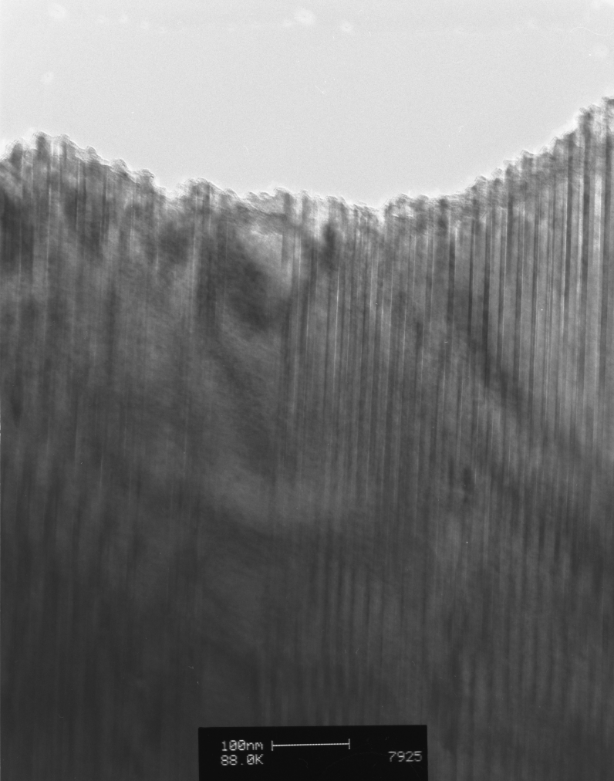
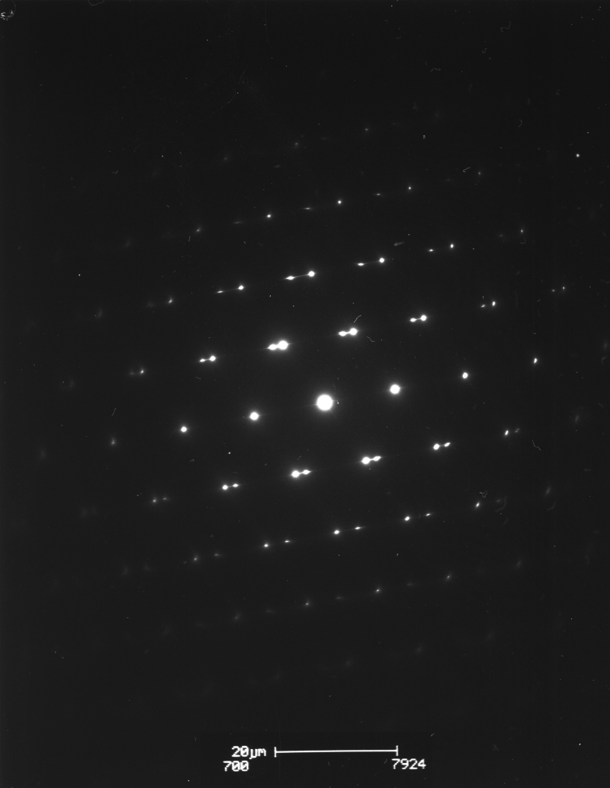

Twinning in diffraction
Example: Co-Ni-Al shape memory FCC twins observed on [1 1 0] zone axis
(1 1 1) close-packed twin planes overlap in SADP
Images provided by Barbora Bartová, CIME

Slide 2
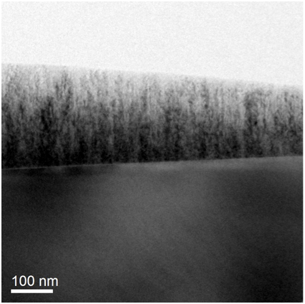
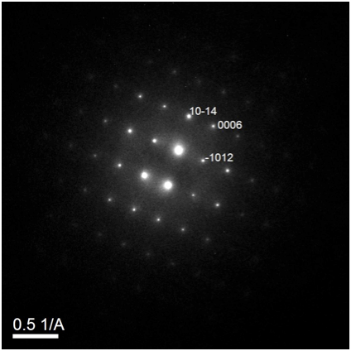
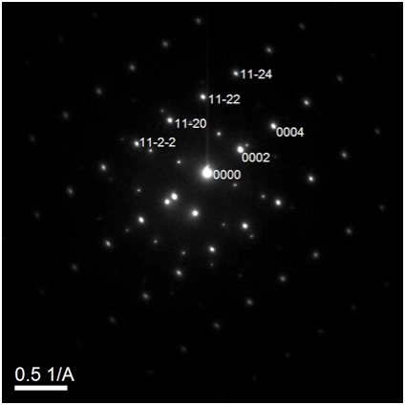
Epitaxy and orientation relationships
SADP excellent tool for studying orientation relationships across interfaces
Example: Mn-doped ZnO on sapphire
Sapphire substrate
Sapphire + film
Zone axes:
[1 -1 0]ZnO // [0 -1 0]sapphire
Planes:
c-planeZnO // c-planesapphire

Slide 3
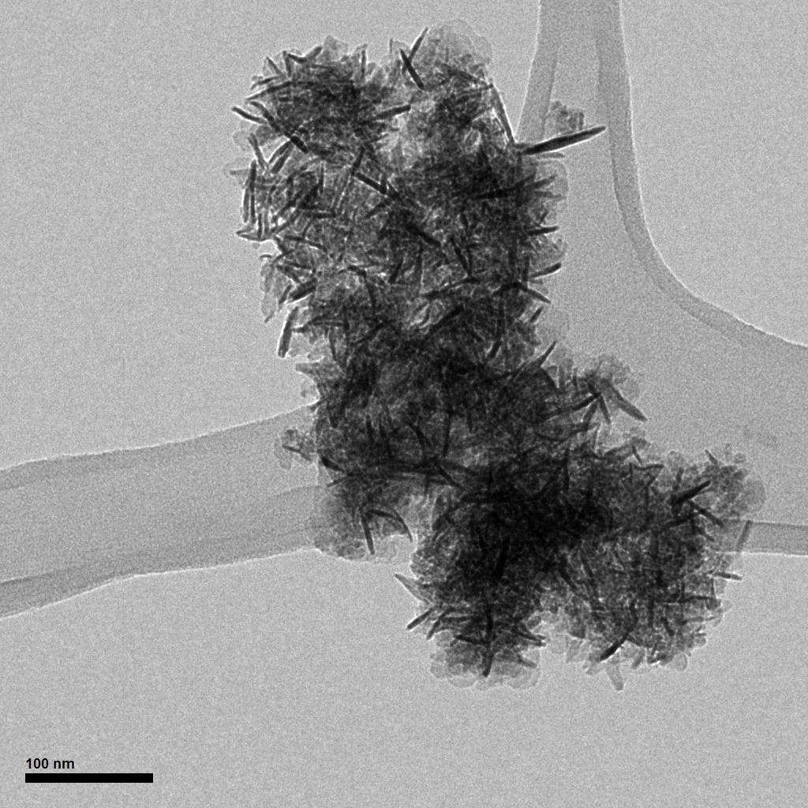
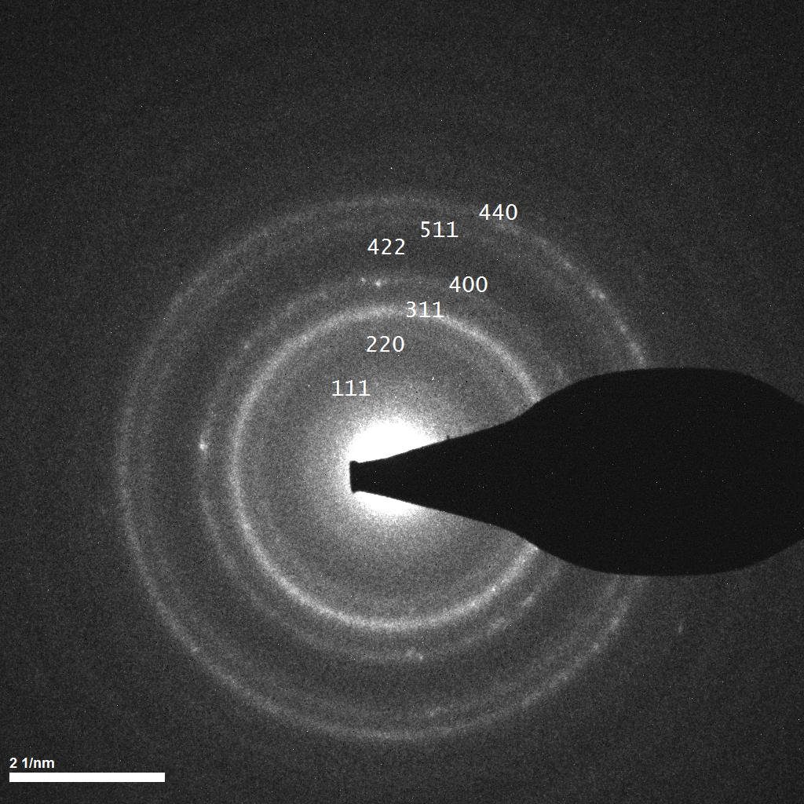
Ring diffraction patterns
If selected area aperture selects numerous, randomly-oriented nanocrystals,
SADP consists of rings sampling all possible diffracting planes
- like powder X-ray diffraction
Example: “needles” of contaminant cubic MnZnO3 - which XRD failed to observe!

Slide 4
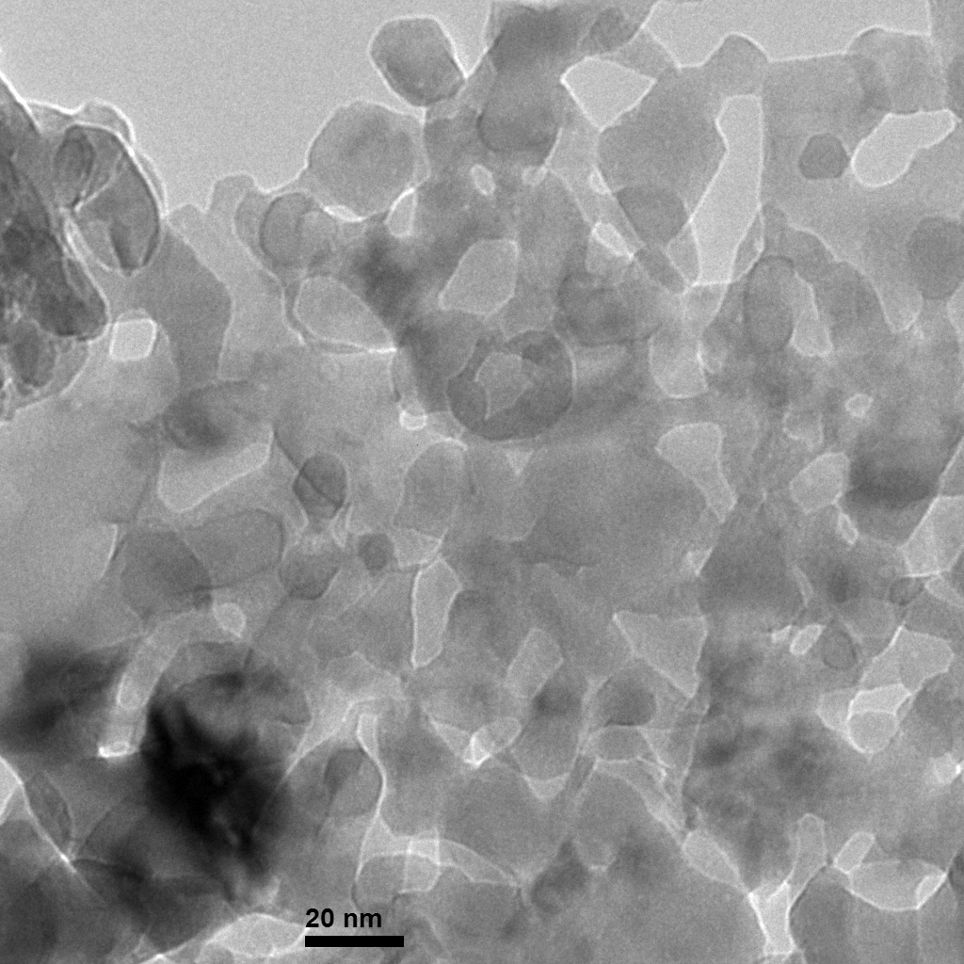
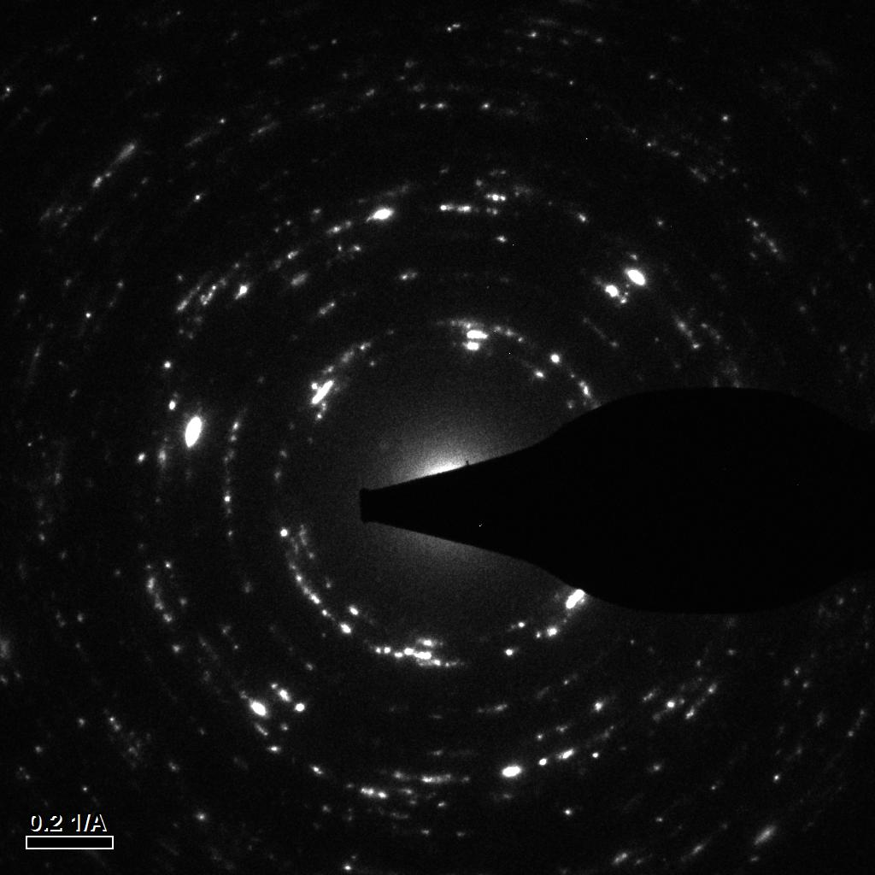
Ring diffraction patterns
Larger crystals => more “spotty” patterns
Example: ZnO nanocrystals ~20 nm in diameter

Slide 5
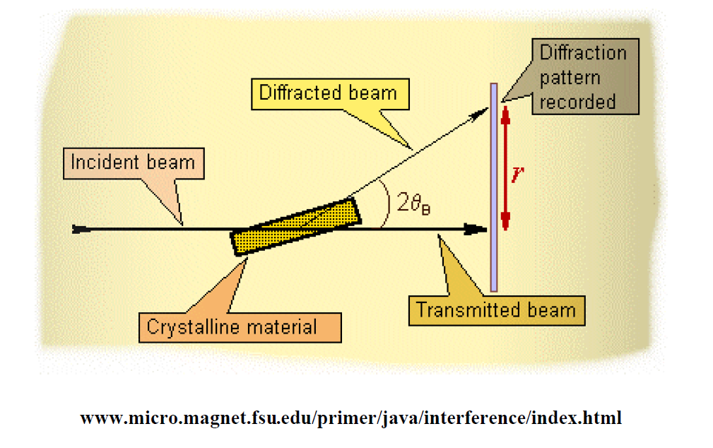
XRD
X-ray diffraction

Slide 6
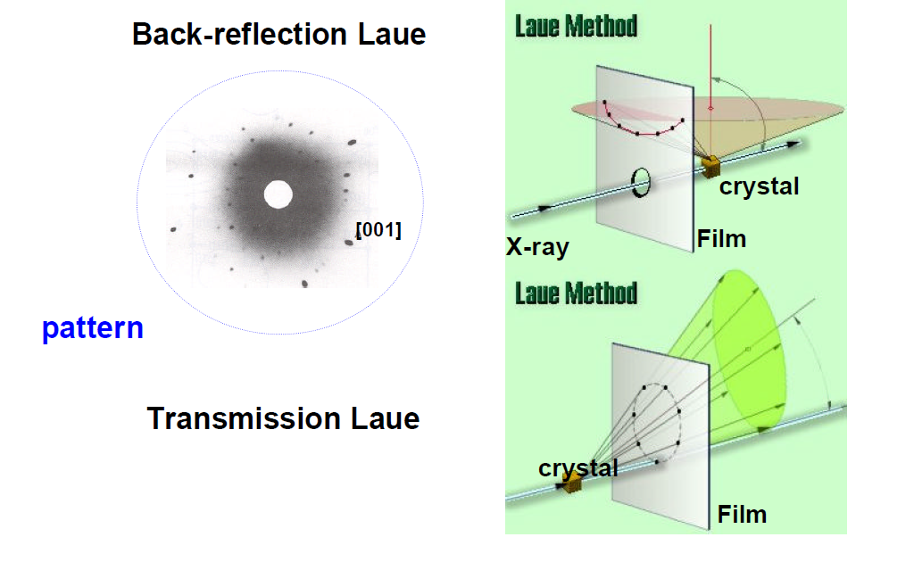
Laue Method

Slide 7
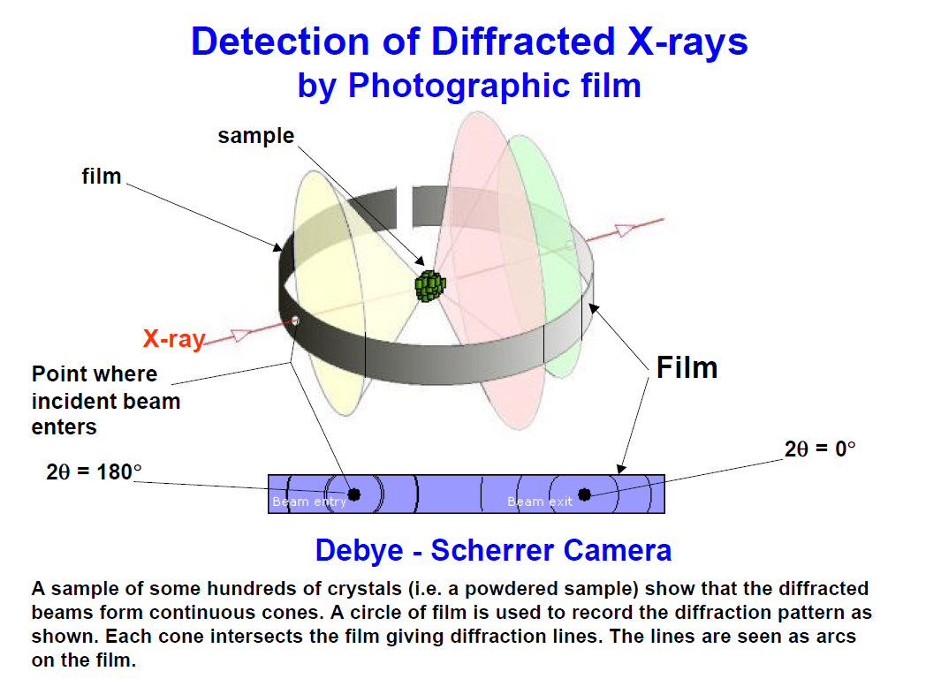
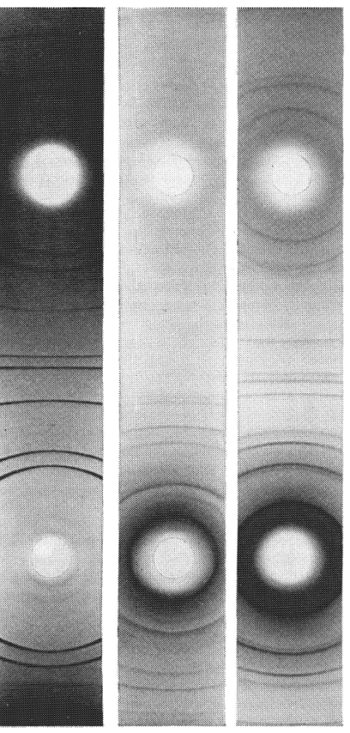
Debeye-Scherrer

Slide 8
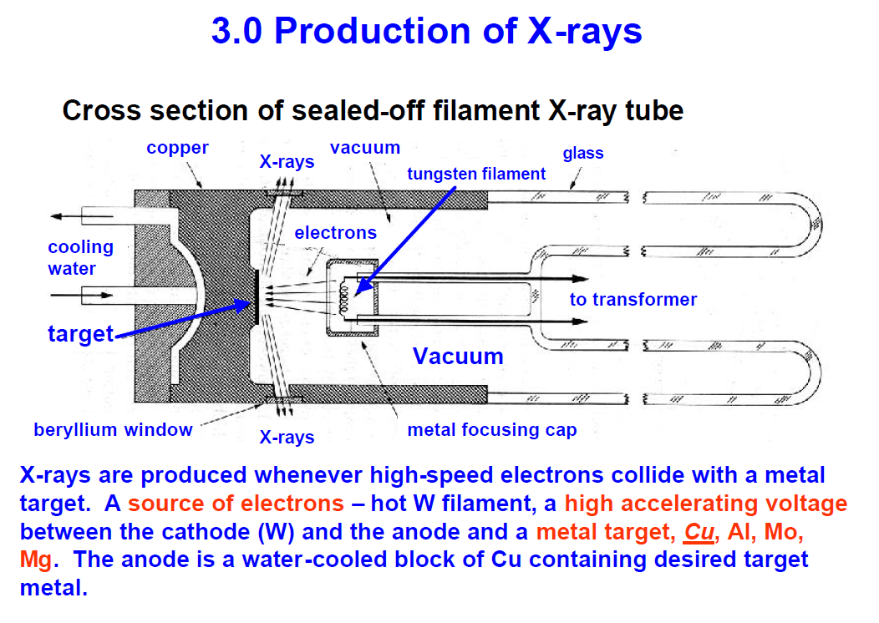
X-ray tube

Slide 9
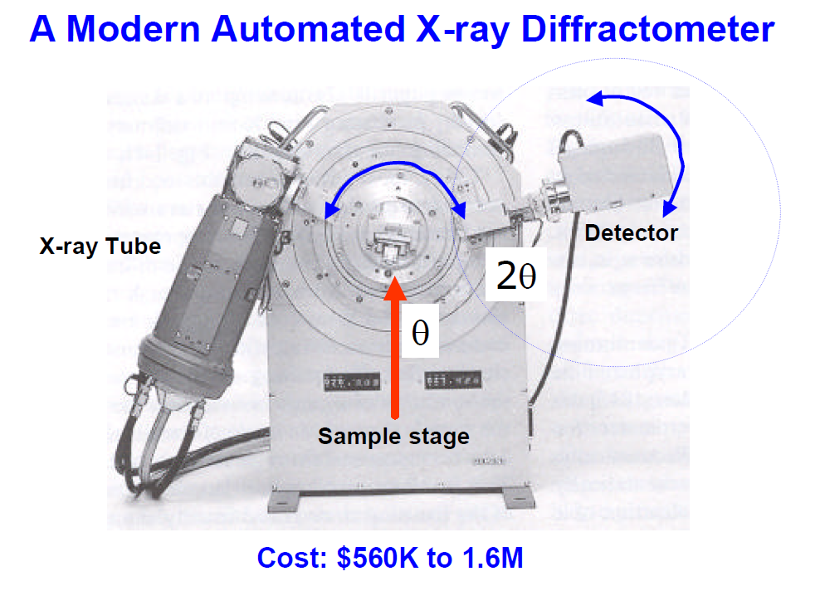
Diffractometer

Slide 10
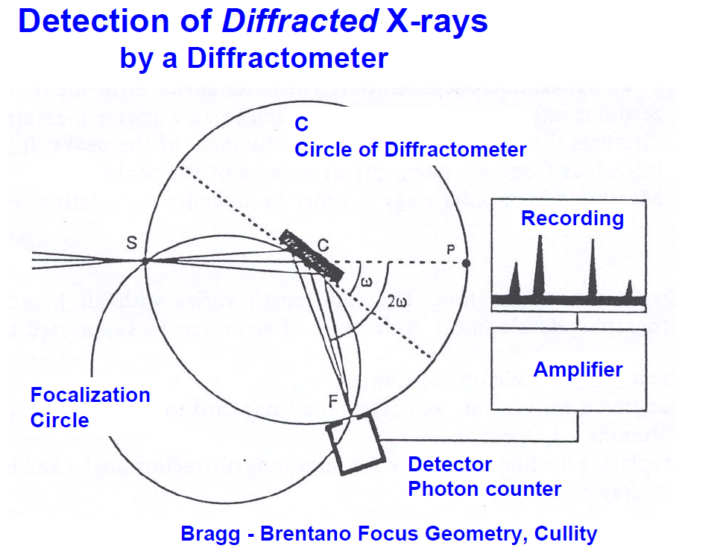

Slide 11
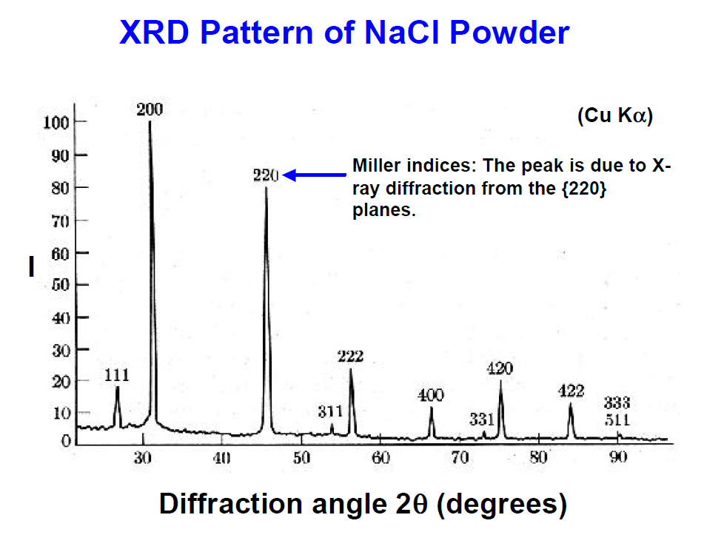

Slide 12
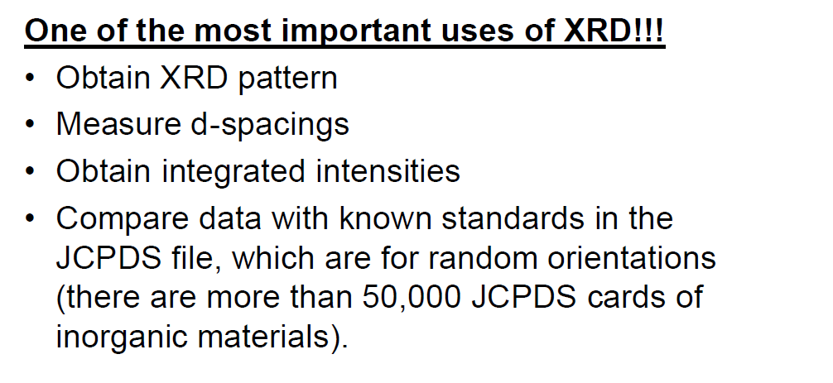

Slide 13
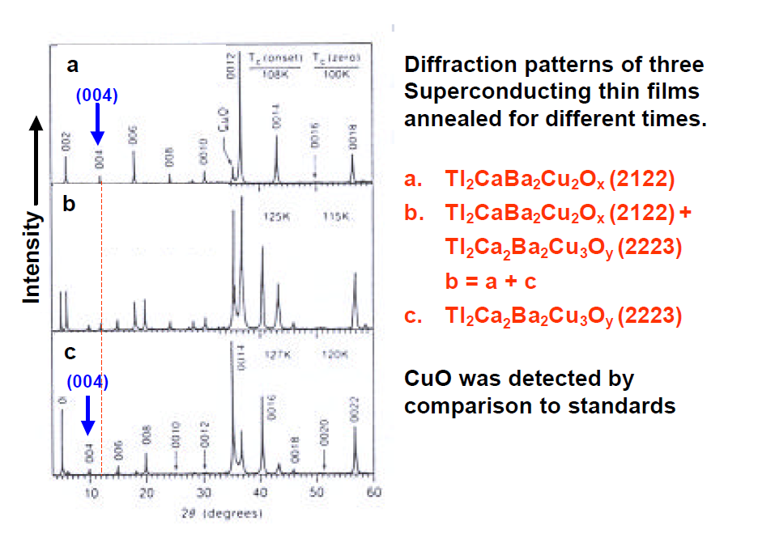

Slide 14
References
“Transmission Electron Microscopy”, Williams & Carter, Plenum Press
“Transmission Electron Microscopy: Physics of Image Formation and Microanalysis (Springer Series in Optical Sciences)”, Reimer, Springer Publishing
“Electron diffraction in the electron microscope”, J. W. Edington, Macmillan Publishers Ltd
“Large-Angle Convergent-Beam Electron Diffraction Applications to Crystal Defects”, Morniroli, Taylor & Francis Publishing
http://escher.epfl.ch/eCrystallography
http://www.doitpoms.ac.uk
JEMS Electron Microscopy Software Java version
http://cimewww.epfl.ch/people/stadelmann/jemsWebSite/jems.html
Web-based Electron Microscopy APplication Software (WebEMAPS)
http://emaps.mrl.uiuc.edu/
http://crystals.ethz.ch/icsd - access to crystal structure file database
Can download CIF file and import to JEMS

